Slide 1
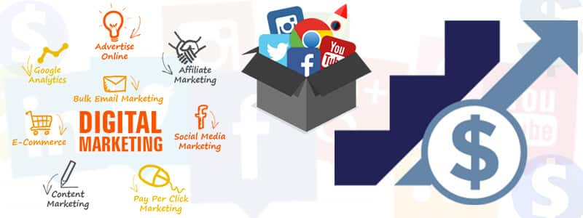
The Digital Marketing Company In Coimbatore

Slide 2
Introduction
If you have recently graduated and are currently remaining on intersection to figure out which way you ought to continue to construct your career then this article can enable you to out as it were. Coimbatore, being the most educated state in India, has a great deal of taught occupation searchers and this article is centered on the activity field of Coimbatore. Nonetheless, if you don't mind remember that whatever course you pick, you require just pick the one that most appropriate your necessities.
You may have heard and perused about how the advanced world is changing to digital. Have you caught wind of how digital marketing is changing on the online business today? This article investigates in-insight concerning what one will realize in a digital marketing course from driving Digital Marketing Company.

Slide 3
Digital Marketing Company Coimbatore
Enhance yourself in one of the best digital marketing company in Coimbatore. We majorly focus on all elements like SEO, SEM, SMM etc.. We also offer advanced Digital marketing training and courses. At once when you complete the course you’ll rather become the master in digital marketing.

Slide 4
Significant segments that make up Digital Marketing
Digital Marketing itself is a tremendous region for discovering that is established of various distinctive parts. When it comes to successful online marketing, the various processes that you undertake, combined together forms digital marketing. Here, we will take look at the most significant components that make up digital marketing.
SEO
SEM
SMM
Content Marketing
Analytics
Email Marketing

Slide 5
SEO & SEM
Search Engine Optimization Company (SEO): This is one term that you could never have missed. It basically is the most fundamental information that each online advertiser ought to have. In SEO, one does systems to naturally win traffic from significant internet indexes like Google, Bing, and so forth. It makes your site prepared and internet search tool well disposed.
Search Engine Marketing Company (SEM): Sometimes, you need to toss in a touch of something to show signs of improvement reach; to more readily advance your business on the internet. Whenever done legitimately, the statures Pay per Click (PPC) can take your business are various. This is an immense subject where you have to find out about how internet based promoting functions and about the different configurations that you can use in this – like pursuit advertisements, flag promotions, video advertisements, GIF promotions and so forth.

Slide 6
SMM
Social Media Marketing : When it comes to online advertising, internet based life is one thing that can't be stayed away from. Through the different internet based life stages, one could consistently connect with clients, assemble a group of people and furthermore acquire some unwavering clients. With Social media getting so prominent among individuals, the potential outcomes are many. There are likewise different stages which can be utilized for focusing on different kinds of crowd. Additionally, there are different enhancement exercises that should be improved the situation boosting the scope of the promotion battle and furthermore to diminish the expense of every advertisement crusade.

Slide 7
Conclusion
The promoting joint efforts a critical job in the achievement of each business and today, all showcasing jobs require information on advanced advertising. So why pause? Locate the best Digital Marketing Companies in Coimbatore, and enhance your profession in advanced digital marketing.
Reach Us on:
Address
No.33, 3rd Cross street, Chandragandhi Nagar, Sowripalayam, Coimbatore, Tamilnadu, India.
Phone : +91 9791804290
Email: digitalmarketingcoimbatore@gmail.com

